Slide 1
Lab 1 Tutorial (Introduction to Java)
CSE 2200 : Advanced Programming
Google Classroom : https://classroom.google.com/c/Njk2Nzk1NTgwMDA3?cjc=sx63jog
Argha Chandra Dhar
Lecturer,
Dept of CSE, KUET
Email: dhar@cse.kuet.ac.bd
Kazi Saeed Alam
Assistant Professor,
Dept of CSE, KUET
Email: saeed.alam@cse.kuet.ac.bd

Slide 2
Why Java is Important?
Trouble with C/C++ language is that they are not portable and are not platform independent languages.
Emergence of World Wide Web, which demanded portable programs.
Portability and security necessitated the invention of Java.

Slide 3
History
James Gosling – Sun Microsystem (June, 1991)
Initially it was designed for small, embedded systems in electronic appliances like set-top boxes. (interactive television).
Initially called “Oak” - In 1995, Oak was renamed as "Java“.
JDK 1.0 was released on January 23, 1996.
Current version JDK 22 as of March, 2024.

Slide 4
What is Java?
Java is a programming language and a platform.
A high level, robust, object-oriented and secure programming language.
Write Once Run Everywhere. (WORA)

Slide 5
How Java is different from C?
Major difference is that C is a structure oriented language and Java is an object oriented language and has mechanism to define classes and objects.
Java does not support an explicit pointer type.
Java does not have preprocessor, so we cant use #define, #include and #ifdef statements.
Java does not include structures, unions and enum data types.
Java does not include keywords like goto, sizeof and typedef.
Java adds labeled break and continue statements.
Java adds many features required for object oriented programming.

Slide 6
How Java is different from C++?
Java doesn't support pointers to avoid unauthorized access of memory locations.
Java does not include structures, unions and enum data types.
Java does not support operator over loading.
Preprocessor plays less important role in C++ and so eliminated entirely in java.
Java does not perform automatic type conversions that result in loss of precision.

Slide 7
How Java is different from C++? (cont..)
Java does not support global variables. Every method and variable is declared within a class and forms part of that class.
Java does not allow default arguments.
Java does not support inheritance of multiple super classes by a sub class (i.e., multiple inheritance). This is accomplished by using 'interface' concept.
It is not possible to declare unsigned integers in java.
In java objects are passed by reference only. In C++ objects may be passed by value or reference.

Slide 8
Features added in Java
Multithreading, that allows two or more pieces of the same program to execute concurrently.
C++ has a set of library functions that use a common header file. But java replaces it with its own set of API classes.
It adds packages and interfaces.
Java supports automatic garbage collection.
break and continue statements have been enhanced in java to accept labels as targets.
The use of unicode characters ensures portability.

Slide 9
Java Environment
Java includes many development tools, classes and methods
Development tools are part of Java Development Kit (JDK) and
The classes and method are part of Java Standard Library (JSL), also known as Application Programming Interface (API).
JDK constitutes of many tools like java compiler, java interpreter and many.
API includes hundreds of classes and methods grouped into several packages according to their functionality.

Slide 10
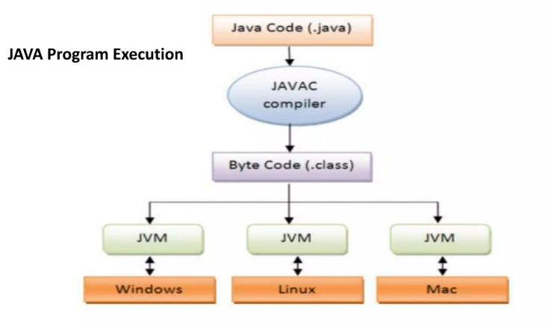
Java Environment

Slide 11
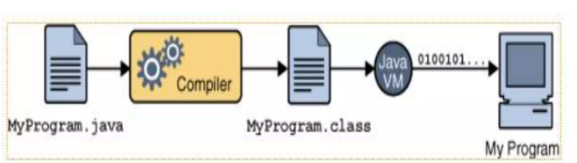
Write Once Run Everywhere

Slide 12
Topic Details
Java
Android and JavaFx
Basic Programing Syntax
Java Threads
OOP Concepts
Inheritance
Polymorphism
Encapsulation
Java collections and Generics
Android/Desktop application Structure
UI Design, Asynctask
Firebase and Database Handling
JSON Parsing
API

Slide 13
Final Project
Android/Desktop Based project (Randomly chosen)
Should Incorporate all the ideas learned throughout the lab
1st Lab Test: 5th Lab (Topic: Skill test on Java)
Project Showcase: 12th Lab
Quiz: 13th Lab

Slide 14
Reference
https://www.w3schools.com/java
https://www.javatpoint.com/java-tutorial
“Java: The Complete Reference” - Herbert Schildt
“Head First Java” - Kathy Sierra and Bert Bates

Slide 15
Thank You!!!

